Slide 1
Occultation Observation with the IOTA Video Recorder
Joan Dunham, Steve Conard, Steve Preston, Russ McCormick

Slide 2
IOTA Video Recorder
IOTA VideoCapture 1.0 is now available
Purpose of this presentation
Show equipment we have used
Describe what we have learned
Inspire others to use IOTA VideoCapture

Slide 3
Computer-Based Recording Systems
Windows desktop or laptop computer + video capture device
Advantages: Most already have access to a computer, screens easy to read, can capture and reduce videos on the same computer
Disadvantages: Desktops need a power outlet, reluctance to leaving laptops unattended in remote locations
A good way to begin
7” or 8” Windows tablet + USB video capture cable
Advantages: Self contained, very portable
Disadvantages: Screens on older (used & cheaper) models can be hard to read, high costs for new models
Mini or stick computer with associated support (keyboard, HDMI monitor) + USB video capture cable
Advantages: Very portable, very discreet in operation as monitor can be removed
Disadvantages: Single purpose, portable screens can be hard to read
Requires some expertise with computers and accessories

Slide 4
Occultation by (107) Camilla
Observed 7/21/2016 from Greenbelt, MD
Equipment:
12-inch Newtonian
PC 164C-EX2 video camera
iView Windows 10 stick computer system (“Occ2” system)
Software - IOTA Video Recorder, Beta 2
Disappearance recorded, reappearance missed by operator error

Slide 5
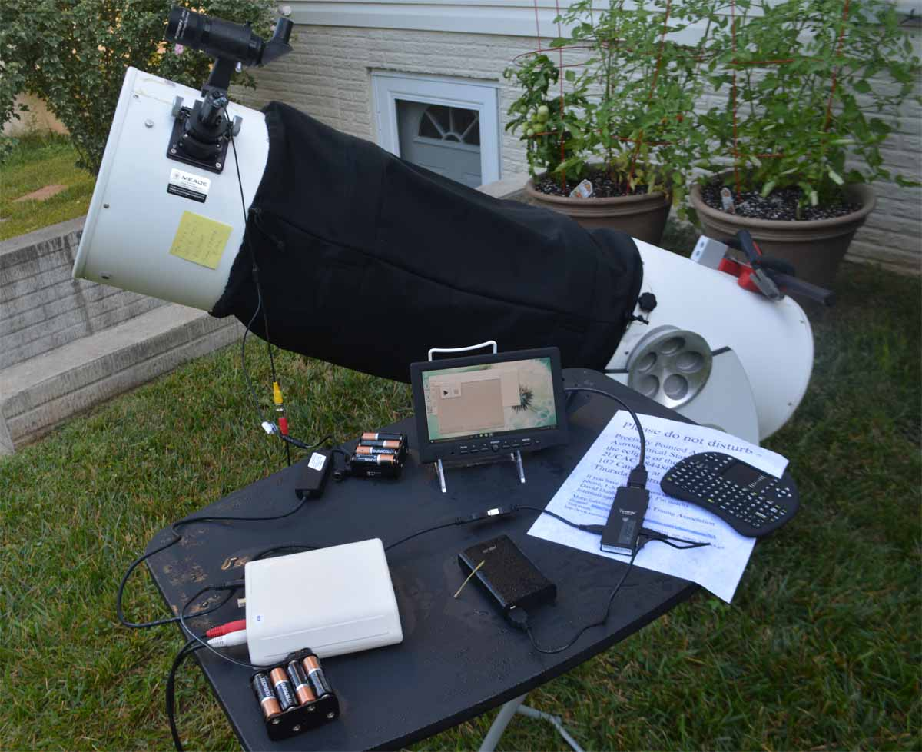
Camilla Observation Recording Setup

Slide 6
Purchased for Recording Occultations
System 1 –“Occ1”
StarTech SVID2USB2 S-Video and Composite Video Capture Cable with Audio TV Tuners and Video Capture – Sold by Amazon, $53.37
recent price $70.56
Kangaroo Mobile Desktop Computer KJ2B#001-NA Intel Atom X5-Z8500 (1.44GHz) 2GB LPDDR3 32 GB eMMC Windows 10 Home, sold by Newegg $99.99
The Kangaroo mini computer needs an HDMI monitor, a keyboard, and a mouse. It has an internal battery, but needs additional support to run for a long period. It has 2 standard USB ports, a USB2 and a USB3
Atomos ATAOMCAB010 Full HDMI to HDMI Coiled Cable (11.8” to 17.7”), sold by B&H, $22.95
ASUS ASZP10050PBK Zen Power 10050 mAh Portable Battery Pack, sold by B&H, $19.99
Logitech MK220 2.4G Wireless Optical 1000dpi Mouse+Keyboard, sold by Newegg, $33.99

Slide 7
Purchased for Recording Occultations
System 2 – “Occ2”
StarTech SVID2USB2 S-Video and Composite Video Capture Cable with Audio TV Tuners and Video Capture, sold by Amazon, $53.37
Recent price $70.56
iView Cyber PC Computer Stick Intel Atom Z3735F (1.33 GHz) 2GB DDR3 32 GB HDD Windows 10 Home, sold by Newegg, $99.99
The iView has no internal battery and also needs an HDMI monitor. It has its own wireless keyboard with a pointer. It has 2 micro USB ports, one dedicated to the wireless dongle for the keyboard.
Adaptor for standard USB to micro USB from store in Australia, <$10
ASUS ASZP10050PBK Zen Power 10050 mAh Portable Battery Pack, sold by B&H, $19.99

Slide 8
Purchased for Recording Occultations
Used by both systems
Bestview 7” Digital Field LCD 800x480 High-definition Monitor HDMI Input, sold by Newegg, $99.99
The Bestview battery holder takes a Sony L-Series battery. It can also use the same AA battery packs we use for the IOTA VTI and PC 164 cameras.
Gibson Holders 2PL Display Stand with Clear Base, Medium, White, 12-Pack, sold by Amazon, $1.34 for one stand
ikan Sony L-Series compatible battery, sold by B&H, $24.95
ikan Sony L-Series compatible battery charger, sold by B&H, $19.95
Total cost for 2 systems: $560

Slide 9
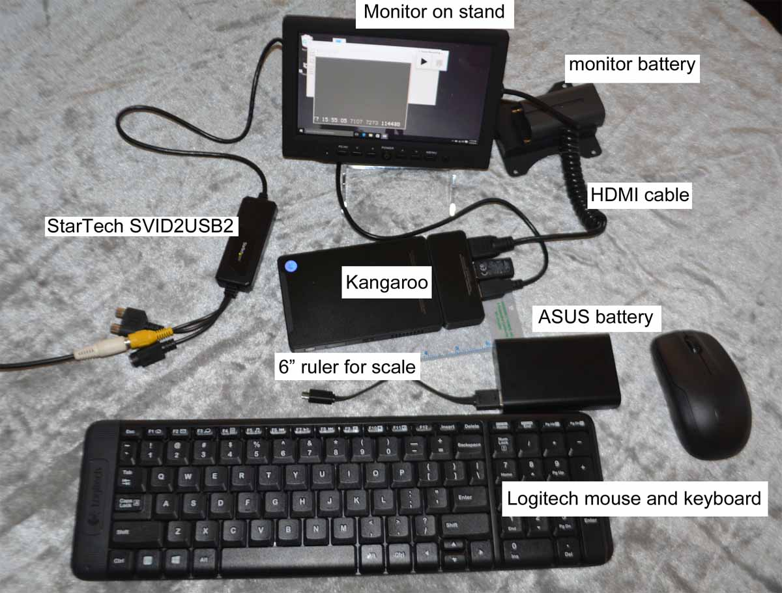
Occ1
Labeled picture TBS

Slide 10
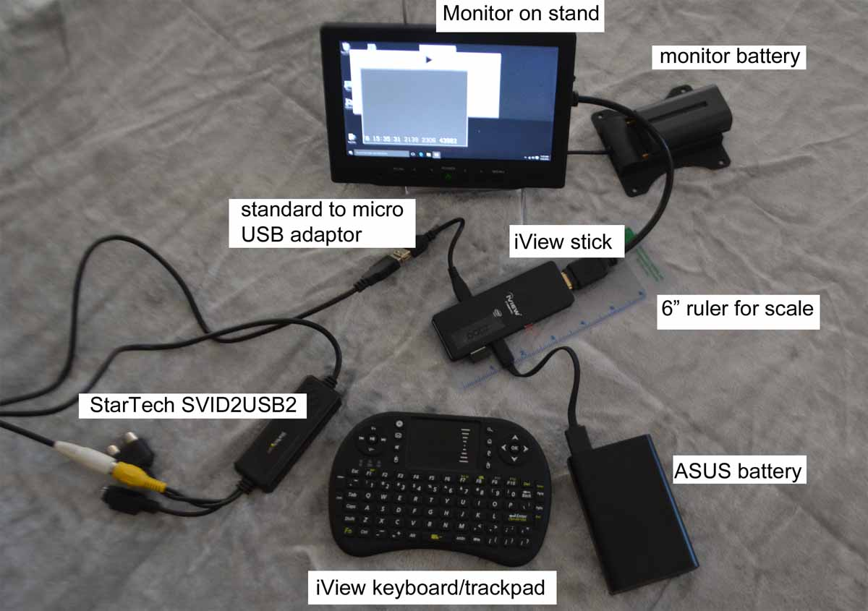
Occ2
Labeled picture TBS

Slide 11
Lowest Cost System – Steve Conard
Ebay purchases:
HP Stream 7 for $70 shipped, effectively a new tablet
List prices for current HP Windows 10 tablets start at $330. Dell’s start at $400.
Star Tech SVID2USB2 adapters from between $14 and $26 shipped
Amazon purchases
microSD card for $15, and the cables for about $10 (both from Amazon).
Total Cost - Approximately $115
Note: If you already have an IOTA VTI and appropriate camera, own a laptop or PC to use for video capture, a computer-based system can be yours with the purchase of a $20 used SVID2USB2 cable from Ebay

Slide 12
Software and OS
Windows 7, 8, 8.1, and 10
Macintosh and Linux systems not supported – there may be options for them from other software but they are outside the scope of this discussion
IOTA VideoCapture
Purpose built for occultation recording with a standard security camera
No camera control from the software
Free
VirtualDub
General purpose video recorder
No longer supported
Free
Runs on Win 7, some Win 8 and Win 10 computers
Will execute on 2 of the 4 Win 10 computers Joan tested: the Kangaroo and a Sony laptop, but not on the iView or an Acer desktop
Lagarith codec
Option for video compression, only necessary if there are severe storage space limitations
Free
Standard general purpose video recording software
Any software that records incoming video will record occultations but may be too big and resource intensive for use with tablets and mini computers

Slide 13
Lessons Learned
Minimize external communications during an observation to reduce the chances of dropped frames during capture
Use airplane mode
Minimize requests to update as much as possible
Do for any Windows system used to capture video, from desktops to tablets!
Set the computer/tablet/mini computer to never sleep
Limit use of USB ports to incoming video capture
Capture incoming video to the computer’s disk, not an external disk or card
Manage disk storage to avoid disappointment
Always check available storage before an event
Do the data reduction on a computer with a full-sized screen with good resolution
Learn how to do backups, create restore points, and how to roll back with a restore point and to restore files

Slide 14
More Lessons
Video recordings can exceed the 4GB limit of USB memory sticks, a USB SSD or external HDD is needed to transfer files
Thumb drives use Fat32 file format
Reformatting to exFat or NTFS is possible but that limits the uses of thumb drives
Using video compression is a choice, not a requirement
None of the tests Joan did used Lagarith. The Dunhams have it, it does work fine, but they do not want to compress the recordings unless absolutely necessary
Make background display dark to avoid screen glare while trying to point the telescope
For mini computers and tablets
Enlarge the icons and fonts
Remove unneeded apps and anything that clutters the screens
Use a stylus if your device has a touch screen
Transfer data with a memory card or USB drive
WiFi transfer from tablets and mini-computers is very slow

Slide 15
Even More Lessons
Everything is black
The wires, the little computers, tiny dongles, power packs, the HDMI monitor
A surprising number of manufacturers identify ports and buttons with black type on a black background. Sometimes its raised type, but it’s still black.
Even worse are manufacturers that do not identify ports and buttons.
There can be a lot of wires, and most of them are black too.
Portable HDMI monitors use a lot of power. They can be operated on AA batteries, but not for long periods.
Windows 10 is not designed to be a system supporting unattended science data collection.
All user accounts must have an email and a Microsoft account, consider establishing a separate account for computers that are potentially accessible to others
Try not to scream too loudly while learning to work within Win10 limitations. That might disturb the neighbors.

Slide 16
Conclusions
IOTA VideoCapture works well
Portable small computers and tablets using IOTA VideoCapture are a very good replacement for Canon camcorders
Thanks, Russ for a great piece of software!

Slide 17
Dunham Testing
Computers
4 Win8 tablets
2 Win10 mini-computers
Win8 laptop upgraded to Win10
Win10 desktop
2 types of cameras – low light level surveillance NTFC 29.97 FPS cameras and computer-controlled color cameras
2 video digitizers
5 programs: IOTA VideoCapture, VirtualDub, SharpCap, FireCapture, EZPlanetary
What is reported is what was they considered the most promising for replacing Canon camcorders for recording occultations

Slide 18
Demonstration
Equipment
Mighty Mini, PC 164C-EX2, IOTA VTI
StarTech video capture cable
Kangaroo mini computer (“Occ1” system)
External HDMI monitor, keyboard, mouse
OS – Windows 10 Home
Software – IOTA VideoCapture

